Slide 1
RTOS

Slide 2
GPOS vs RTOS
GPOS
used for systems/applications that are not time critical.
Eg. Windows, Linux, MacOS.
RTOS
is used for time critical systems.
Eg. Freertos, usOS, vxWorks.

Slide 3
Types of Real Time Systems
Hard Real Time Systems
Soft Real Time Systems
Firm Real Time Systems

Slide 4

Hard Real Time Systems
Time is a hard constraint. A late response, even if correct is unacceptable.

Slide 5

Soft Real Time Systems
Must handle events promptly, but the constraints are not as well defined.

Slide 6
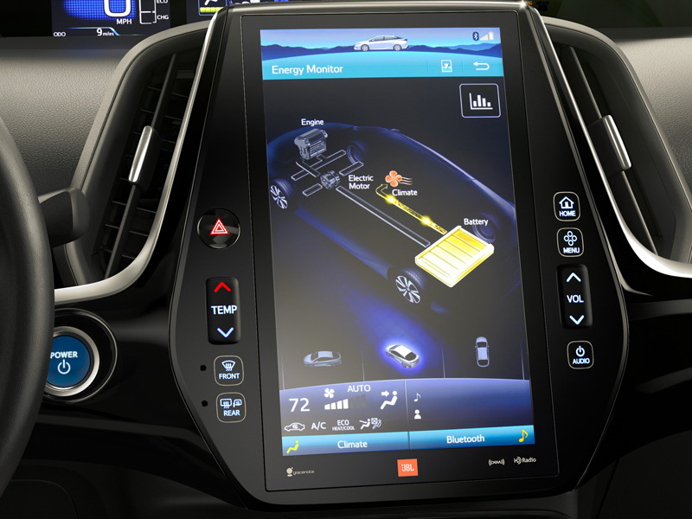
Firm Real Time Systems
Late computation is useless, but not cause serious damage.

Slide 7
Features of an RTOS
Multitasking
Constant Task Switch Time
Low Interrupt Latency
Task Priority
Preemptive Scheduling
Low memory Requirement

Slide 8
Characteristics of an RTOS
Determinism - Predictable output
Responsiveness - Quick response
Reliability - Highly stable
Fail Soft Operation - prevents total system failure
Scalability - adaptable to changes

Slide 9
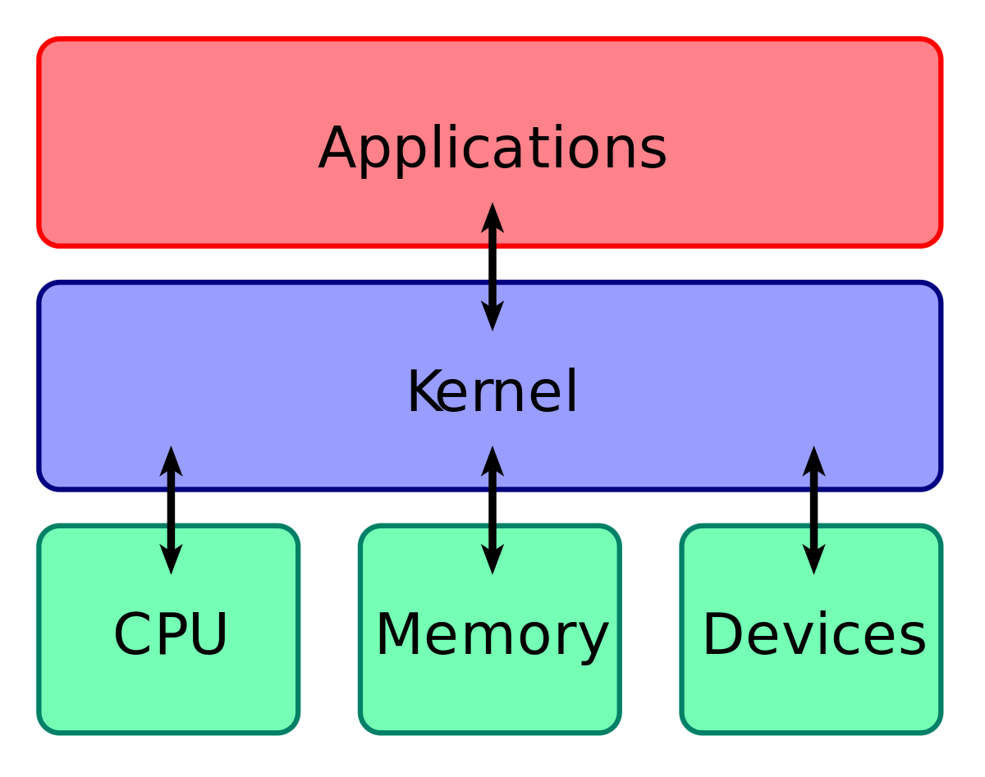
Kernel
The kernel is a computer program that is the core of a computer's operating system, with complete control over everything in the system. On most systems, it is one of the first programs loaded on start-up (after the boot loader).

Slide 10
Types of Kernel
Non-preemptive
Preemptive

Slide 11
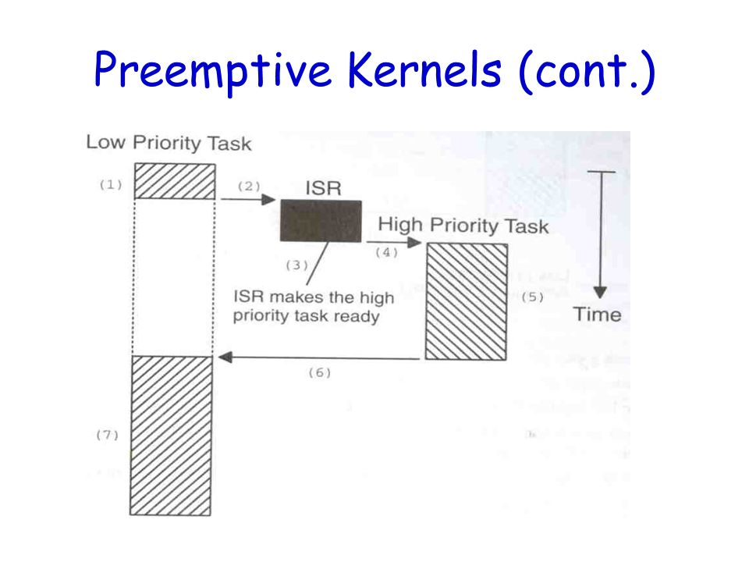
Preemptive Kernels
A preemptive kernel is used when system responsiveness is important. With a preemptive kernel, the kernel itself ensures that the highest priority task ready to run is always given control of the CPU.

Slide 12
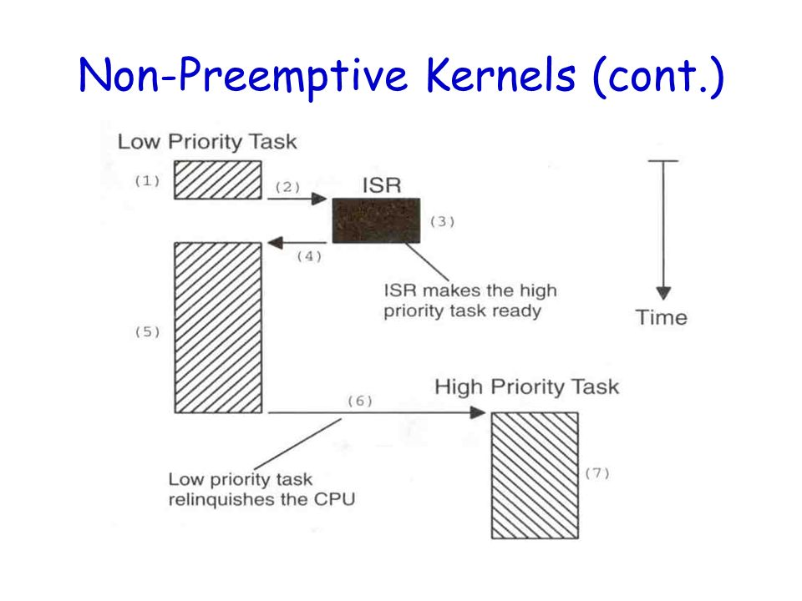
Non-Preemptive Kernels
Non-preemptive kernels require that each task does something to explicitly give up control of the CPU (i.e. microprocessor).
The new higher-priority task will gain control of the CPU only when the current task gives up the CPU.

Slide 13
Kernel Functions
Multi Tasking and Scheduling
Preemptive
Non-preemptive
Inter Process Communication
Direct Method
Indirect Method
Synchronization
Semaphore
Mutex
Interrupt Handling
Device Drivers

Slide 14
Task
A task is a simple program which thinks it has the microprocessor all to itself. Each task is given a priority based on its importance.
The design process for a real-time system consists of splitting the work to be done into tasks which are responsible for a portion of the problem

Slide 15
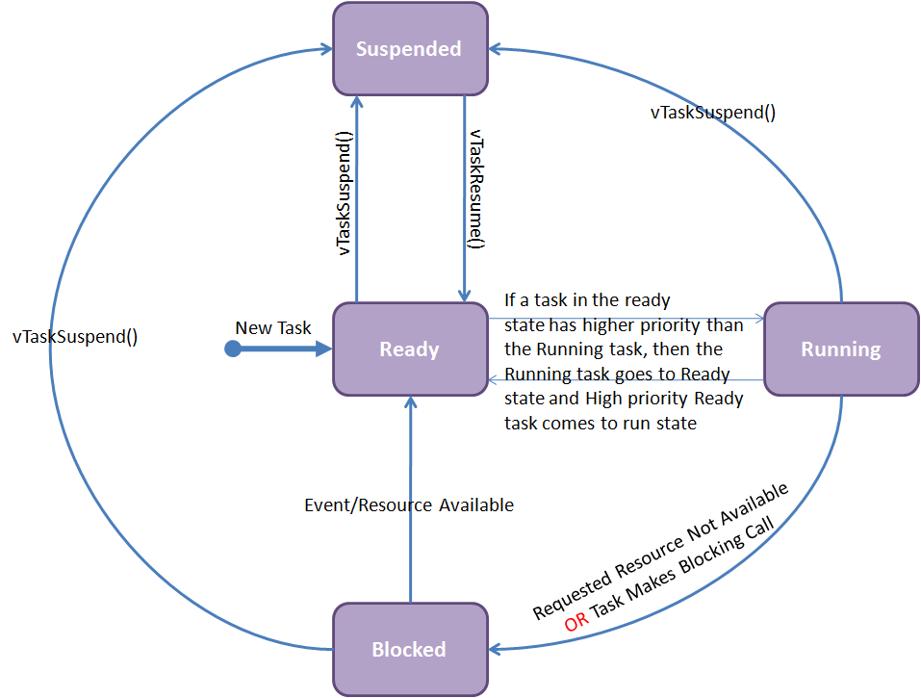
Task States
Ready:
Blocked:
Running:
Suspeded:

Slide 16
Thread
A thread of execution is the smallest sequence of programmed instructions that can be managed independently by a scheduler, which is typically a part of the operating system. Most modern systems deal with thread rather than process .
Thread
Process
Thread
Program
Process
Thread

Slide 17
Classification Of Threads
Time Threads (eg: only on system failure)
Event Triggered Thread(eg: runs when flag is high/low)
Main Threads

Slide 18
Thread Control Block
Thread Control Block (TCB) is a data structure in the operating system kernel which contains threads information needed to manage it. The TCB is "the manifestation of a thread in an operating system.
TCB must Contain:
Pointer to Stack
Pointer to the next thread
Additionally
Variable to hold thread status
Variable to hold thread ID
Variable to hold thread period
Variable to hold thread burst time
Variable to hold thread priority

Slide 19
Sample TCB
Struct tcb
{
int32_t *stackPt;
struct tcb *nextPt;
uint32_t status;
uint32_t period;
uint32_t burstTime;
}

Slide 20
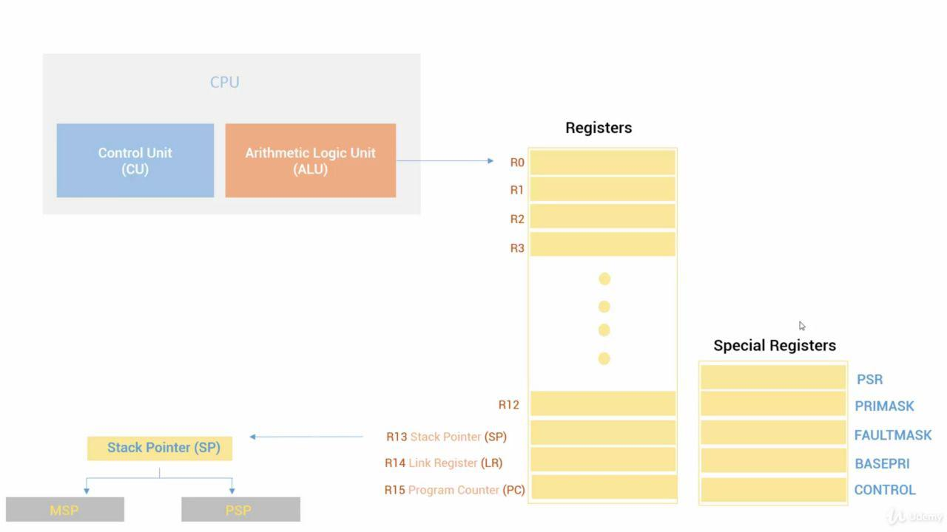
Context Switching
A context switch is the process of storing the state of a process or of a thread, so that it can be restored and execution resumed from the same point later.

Slide 21
Scheduler Algorithm
Cooperative / Non-Preemptive Scheduling
Shortest job first scheduling algorithm
First come first served algorithm
Earliest Deadline First approach
Preemptive Scheduling
Round-robin scheduling algorithm
Shortest remaining time first scheduling algorithm
Static Time Scheduling algorithm [fixed time for varied overhead task]

Slide 22
GAANT CHART SHOWS THE TIME FOR EACH PROCESS WITH SCHEDULER.
-STARVATION PBLM, ANY PRIORITY BASED SCHEDULING ALGORITHM(SJFS,SRTF) WILL SUFFER(WHICH IS PROCESS WAITING INDEFINITLY)
-CONVOY EFFECT,SMALL PROCESS WAITING FOR THE LARGEST PROCESS TO COMPLETE.FCFS AND SJFS(IF LARGE TASK COMES FIRST, IT WILL CONTINUE EXECUTION) SUFFER FROM IT.

Slide 23
Task synchronization
Semaphore
Semaphore is a process synchronization tool. Semaphore is typically an integer variable S that is initialized to the number of resources present in the system and the value of semaphore can be modified only by two functions wait() and signal() apart from initialization.
The wait() and signal() operation modify the value of the semaphore indivisibly. It means that when a process is modifying the value of the semaphore, no other process can simultaneously modify the value of the semaphore.
Mutex
Mutual Exclusion Object is shortly termed as Mutex. From the term mutual exclusion, we can understand that only one process at a time can access the given resource. The mutex object allows the multiple program threads to use the same resource but one at a time not simultaneously.
When a program starts it request the system to creates a mutex object for a given resource. The system creates the mutex object with a unique name or ID. Whenever the program thread wants to use the resource it occupies lock on mutex object, utilizes the resource and after use, it releases the lock on mutex object. Then the next process is allowed to acquire the lock on mutex object.

Slide 24
Types of Semaphore
Counting semaphores
Binary semaphore
A semaphore is a nonnegative integer count. Semaphores are typically used to coordinate access to resources, with the semaphore count initialized to the number of free resources. Threads then atomically increment the count when resources are added and atomically decrement the count when resources are removed.
When the semaphore count becomes zero, indicating that no more resources are present, threads trying to decrement the semaphore block wait until the count becomes greater than zero.
Binary semaphore can have a value either 0 or 1. It means binary semaphore protect the access to a SINGLE shared resource, so the internal counter of the semaphore can only take the values 1 or 0.
So whenever you have a requirement for protecting the access to a SINGLE resource accessed by multiple threads, you can use Binary Semaphore.

Slide 25
Inter Task Communication
The term inter-task communication comprises all mechanisms serving to exchange information among tasks.
Direct
Pipes
Indirect
Mailbox
Ques

Slide 26
Mailbox
A mailbox is simply a storage location, big enough to hold a single variable of type ADDR, access to which is controlled so that it may be safely utilized by multiple tasks. One task can write to a mailbox. It is then full, and no task can send to it until a task does a read on the mailbox or the mailbox is reset. Trying to send to a full mailbox or read from an empty one may result in an error or task suspension.

Slide 27
Que
A queue is a FIFO (First In First Out) type buffer where data is written to the end (tail) of the queue and removed from the front (head) of the queue. It is also possible to write to the front of a queue.
A queue can either hold the data or pointer to the data.
Queue can also be used as semaphore, mutex, event flag, etc.

Slide 28
Pipes
A pipe is a technique for passing information from one program process to another.
A pipe is one-way communication.
a pipe passes a parameter such as the output of one process to another process which accepts it as input.
The system temporarily holds the piped information until it is read by the receiving process.

